Slide 1

Data Science Report: Analysis of BA Reviews
By Ibrahim Suleiman
2023

Slide 2
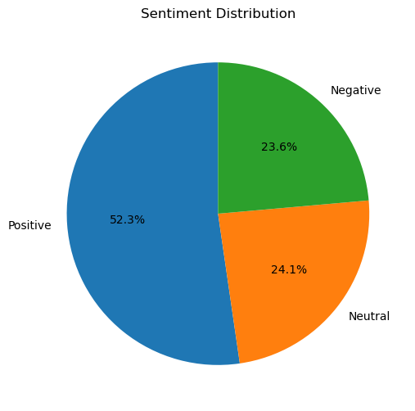
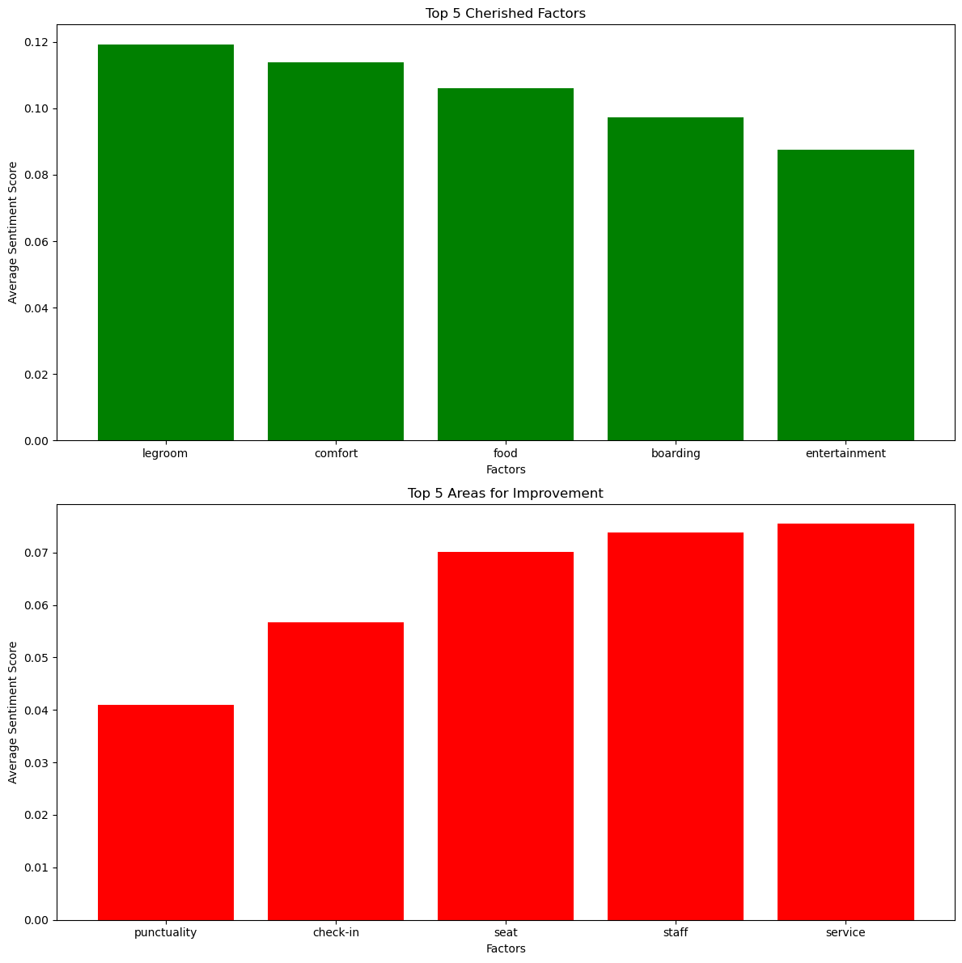
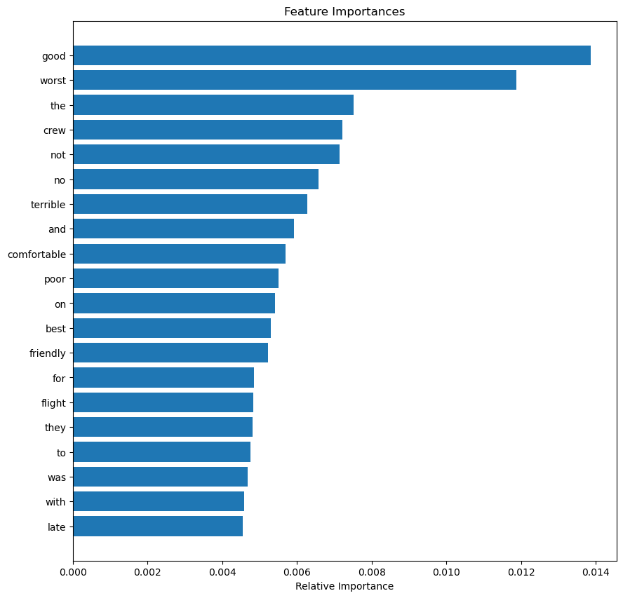
Results
Sentiment
Out of 1000 reviews, 523 were positive, 241 were negative and
241 were neutral. This means the good quantity of reviews were
polarised as either positive or negative
Key topics
The frequency chart below shows that the key topics within the
reviews include “legroom”, “boarding”, “crew” and “food”, showing that
customers are actively talking about their experience and comfort.

